Slide 1



ONLINE MEDICAL MANAGEMENT SYSTEM
Presented by Mediverse

Slide 2

TEAM MEMBERS
Sanjaynath Reddy 22BTRCO011
C.Keerthi Reddy 22BTRCO014
D.Poojitha 22BTRCO015
Lingam Sudheendhri 22BTRCO024
Winnarasi M S 22BTRCO056
Nanda Devi Mishra 22BTLCO001

Slide 3

INTRODUCTION
Define the problem: Difficulty in accessing healthcare, scheduling appointments, and managing records manually.
Purpose: To connect patients and doctors digitally and streamline medical services.
Technologies: Java, JSP/HTML, JDBC, Servlets, MySQL

Slide 4

OBJECTIVE
Simplify appointment booking
Access medical history, lab reports, and e-prescriptions
Enable doctors to manage patient data efficiently
Provide emergency support (blood/eye donor search)

Slide 5

METHODOLOGY
1.Requirement Analysis
2. System Design
3. Implementation (Coding)
4. Testing
5. Deployment
6. Future Enhancements

Slide 6
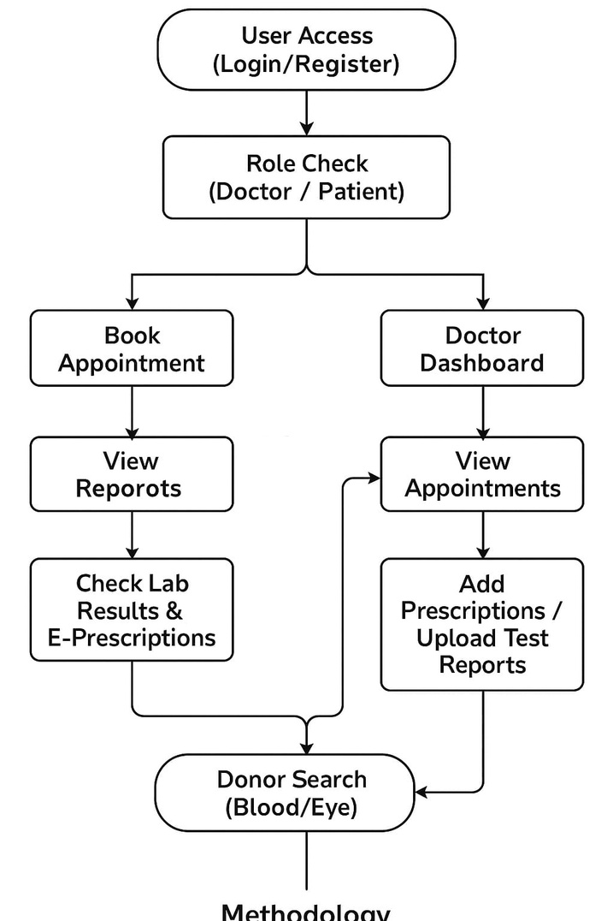
IMPLEMENTATION
Workflow:
1. User registration/login
2. Doctor/patient dashboard
3. CRUD operations for appointments, reports, prescription

Slide 7

ADVANTAGES
Reduces hospital visits
Saves time
Data securely stored
Emergency response with donor support

Slide 8

FUTURE SCOPES
Mobile application integration
AI-based health recommendations
Integration with IoT Devices
Online payment gateways
Global Reach and Multi-Language Support
Improved Data Security

Slide 9

CONCLUSION
Improves efficiency in appointment booking, report handling, and prescription sharing.
Enhances accessibility and safety, reducing the need for unnecessary hospital visits.
Life-saving feature: Integrated donor search function ensures rapid emergency response.

Slide 10
Thank you

